Slide 1

Microservices in Node.Js
Presented By:
Gayel ABOU IMAD
Cindy CHEDID AL RAHBANI

Slide 2
Content
Introduction
Definition
Advantages and drawbacks
MongoDb
Docker
Creating Microservices in Node Js
Implementation
MongoDb
Implementing the Front-End - Angular 8
MVC architecture
Using Docker
Connecting services using MQTT protocol
HeartBeat
Conclusion

Slide 3
Introduction

Slide 4
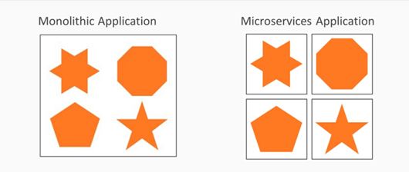
Definition
Applications are traditionally “monolithic” which means they are built as a single, autonomous unit. Everything is contained inside the unit. Microservices are an architectural approach based on building an application as a collection of small services.
Notes:
So, scaling specific functions or components of the application, also means you must scale the entire system.
Other problems with a monolithic approach are :
Inflexibility
Potentially unreliable
Unscalable
Not suitable for continuous dev
Slow development

Slide 5
Advantages of using Microservices
Allows us to build, operate and manage services independently
Microservices take a lot of infrastructure risk out of the project straight away
Each developer on a team can avoid getting tangled up in the underlying infrastructure
Microservices have their own load balancer and execution environment
Finally microservices offer language and platform freedom

Slide 6
Drawbacks of microservices
Microservices are not automatically the right solution for every project.
One of the big problems with microservices is “orchestration”.
Another complex process is “discovery” which is how applications and (micro)services locate each other on a network.
There is a risk in getting a very fragmented system where developers need to spend a lot of time and effort on gluing together services and tools
Microservices can also require increased testing complexity

Slide 7

MongoDb
MongoDB is a distributed database at its core, so high availability, horizontal scaling, and geographic distribution are built in and easy to use.

Slide 8
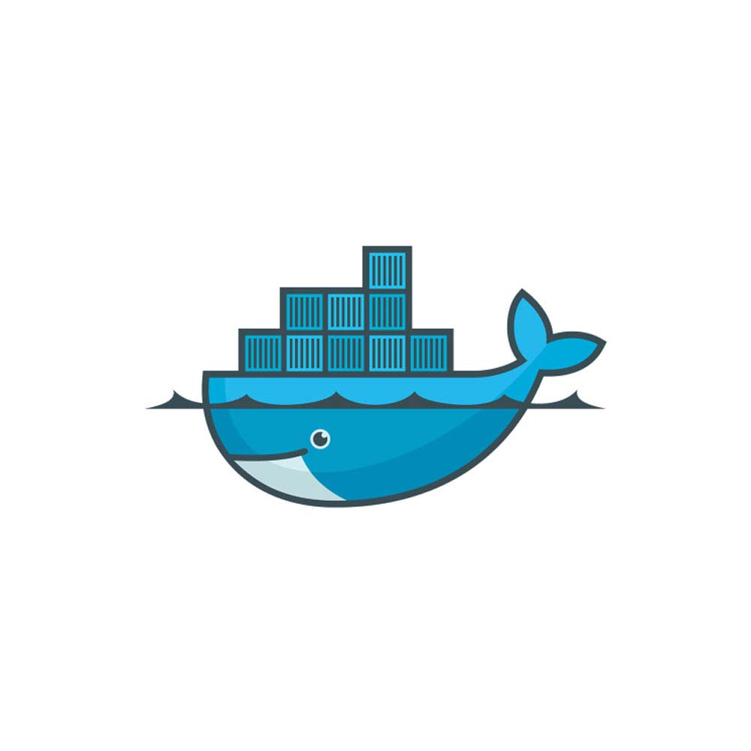
Docker
Docker is an open-source technology used mostly for developing, shipping and running applications. With it, you can isolate applications from their underlying infrastructure so that software delivery is faster than ever.

Slide 9
Docker - Containerization
It solves the problem of how to reliably move software between environments
Encapsulates the entire runtime environment
Includes the application and its dependencies, libraries and other binaries

Slide 10
Docker - example
As an example, we can test the following command
$ docker run hello-world
Or
$ docker run -it ubuntu bash
To create a container:
$ docker run --name <container_Name> -it <image_name>

Slide 11
Creating microservices with Node.Js

Slide 12
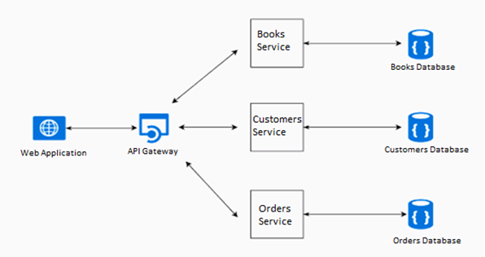
Visualization of the problem
Notes:
Let’s consider we want to create an application where customers are invited to order books.
Using microservices, we will need to create for each of the three entities: book’s entity, customer’s entity and ordering’s entity a service in a backend folder. And then for each service we will have to create its own database. Finally, each service will be deployed in a container (Docker’s container), and the three services will be able to interact with each other’s with the help of the API Gateway.
The following schema explains the whole situation.

Slide 13
Implementing the services
The three services that we need to create in our backend folder of the application are:
Book service
Customer service
Ordering service
API GATEWAY MQTT
Customers
Books
Orderings
Notes:
These services will communicate with the API Gateway through API calls and MQTT publish/subscribe protocol.

Slide 14
Implementing the services
Two main .js files are implemented in each microservice:
DataAccess.Js: In DataAccess.js, an asynchronous function getEntities is implemented in order to make the connection to the corresponding collection in the database.
DataAccess.prototype.GetEntities = async function (dbName, CollectionName)
EntityModel.Js: In EntityModel.js, an asynchronous function getInventory is implemented calling the function getEntities giving it the right arguments: database name and collection name corresponding to the entity service.
Model.prototype.GetInventory = async function(){ Try{ var response = await DataAccess.GetEntities('books_microservice', 'books'); return response;

Slide 15
Using MongoDb
As we said the connection to the database from the application is easier when we use mongodB package. So, to grant the access we need to set the following:
var DataAccess = function(){ this.MongoClient = require('mongodb').MongoClient, assert = require('assert'); this.Mongo = require('mongodb'); this.DBConnectionString = 'mongodb://mongo:27017'; };
Notes:
For each of our services, a different database is needed, database for the books, database for the customers and a database for the orderings.

Slide 16
Implementing the Front-End

Slide 17
Creating the services in the Front-End
In order to fetch data, a service needs to be created. For example, in the terminal in the services folder, the following command needs to be written: $ ng generate service <Service_Name>
In this service you will need to do an Http request, so you need to import the Http module in the app module. import { HttpClientModule } from '@angular/common/http';

Slide 18
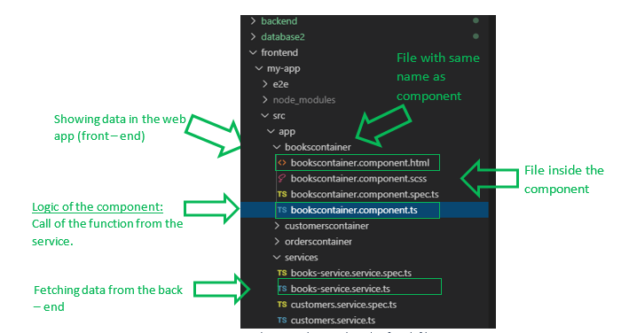
Division of the folders
We have created a component for each service. The following figure show the different parts of a container.

Slide 19
Call to the back-end
And finally, to make the call to the backend, a function should be implemented in each service. This function will be called by the container’s component. Example:
getBooks() { const httpOptions = { headers: new HttpHeaders({ 'Content-Type': 'application/json', 'Access-Control-Allow-Origin': '*', 'Access-Control-Allow-Credentials': 'true' }) }; return this.http.get('http://192.168.99.100:8080/getBooks', http Options);}

Slide 20
Fetching Data in the container
In the Books Container, we should fetch the data in the component.ts file this function will be used as follows: public books; constructor(private booksService: BooksServiceService) { } ngOnInit() { this.showBooks();
} showBooks() { this.booksService.getBooks() .subscribe((data) => { this.books = data;
});
}

Slide 21
Showing Data in the Web application
After fetching the data in the component ts file. We should show it in the html.
Since the data in ts is binded to the data in the ts we can simply use the books object that's in the ts by using {{ books }} in the html file as follows:
<div *ngFor="let book of books"> {{book.name}} </div>

Slide 22
Using MVC architecture

Slide 23
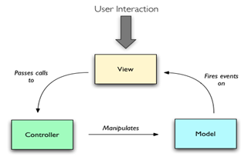
As we can see, in both the front-end and the back-end the architecture used is the: Model – View – Controller architecture.

Slide 24
MVC in front-end and back-end
Using MVC in the front-end
In the front-end, the MVC architecture is followed as following:
Model: Entity-service.ts – file where the data is being fetched
View: EntityContainer.component.html – file where the design and the representation of the app is written.
Controller: EntityContainer.component.ts – file where the logic is built, the function from the service is called and given to the html file.
Using MVC in the back end
In the back-end, the MVC architecture is followed as following:
Model: DataAcess.js – where the data is being transferred from and to mongo DB
View: app.js
Controller: EntityModel – where the function of the DataAccess is called and given to the app.js

Slide 25
Docker

Slide 26
Docker Files
A dockerFile is the main configuration of the docker container. We can set all we need in a single file as follows. The followings is an example of a Docker file corresponding to a microservice:
1. FROM node:latest 2. COPY . /src 3. WORKDIR /src 4. RUN npm install 5. EXPOSE 8081 6. CMD node app.js
Notes:
Here we are setting the environment
Now we need to copy all the books service folder to the container. This means the current directory and /src is the destination folder in the container.
Set the working directory in the container.
The command that should be ran before building the service.
In order to make the calls to the backend we call on port 8081. now that the service is in the container. This port should be binded to the microservices port which is 8081 so we expose port 8081.
start the app (microservice) so we set the command.

Slide 27
Docker compose
If we have multiple docker file, it is better to create a docker compose which will run them all in once. This is a part of our docker compose file. We specify the build file which is the docker file corresponding to each microservice and the local port that will be binded to the container’s port.
# Front End Frontend: container_name: FrontEnd build: ./frontend ports - "4200:4200"
# Service #0 API Gateway Apigateway: container_name: APIGateway build: ./backend/APIGateway ports - "8080:8080"
# Service #1 Books Service Books: container_name: BooksService build: ./backend/booksservice Ports: - "8084:8084"
Etc ..

Slide 28
MQTT

Slide 29
Connection between front-end and back-end
As mentioned before, the front – end fetches data from the back – end by making http request (post) requests on port 8080.
Now how can we make the three services in the back – end share information and talk to each other? MQTT is the answer.
Front - End
Api Gateway (Back-end)
HTTP Requests

Slide 30
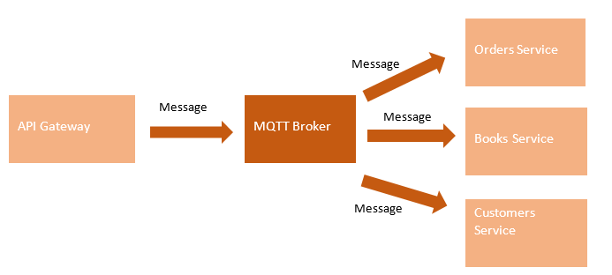
MQTT connection
Now how can we make the three services in the back – end share information and talk to each other? MQTT is the answer.
MQTT is a simple messaging protocol, designed for constrained devices with low bandwidth.
MQTT allows to send commands to control outputs, read and publish data from and to multiple interfaces.

Slide 31
Implementation
As we mentioned in the paragraph above. The API gateway will receive the order from the front end as a JSON which format will be :
let data = { "bookID": this.selectedBook, "ClientID": this.selectedCustomer }
These fields are filled using 2-way data binding feature. Angular provides this feature as follows:

Slide 32
Implementation - Publishing messages to the topic (from the Api - Gateway)
Using MQTT as follows in the API Gateway, the JSON will be published to the 3 services in order to update each of the corresponding databases.
app.post("/receiveOrder", async function (req, res) { console.log("fet 3al received", req.body.bookName) var client = mqtt.connect('mqtt://192.168.16.7:1883'); ⇒ Connection to the local MQTT Server client.on('connect', function () { console.log("Connected") client.subscribe('GayelTest', function (err) { ⇒ Subscription to the broker console.log("Subscribed") var message = JSON.stringify(req.body); if (!err) { client.publish('GayelTest', message) ⇒ Publish the message of the order to the broker } else console.log("erroor") }) }) client.on('message', function (topic, message) { // message is Buffer console.log(message.toString()) res.send(message.toString()) client.end() })});

Slide 33
Implementation - Receiving messages from the topic (from the Services)
var client = mqtt.connect('mqtt://192.168.16.7:1883') client.on('connect', function () { ⇒ Connection to the local MQTT Server console.log("Connected") // Client Subscription client.subscribe('GayelTest', function (err) { ⇒ Subscription to the topic console.log("Subscribed"); if(err){ console.log("error"); } }) }) When someone else publishes data client.on('message', function (topic, message) { // message is Buffer let message2 = JSON.parse(message.toString()); ⇒ Message received model.orderBook(message2.bookID); }) ⇒ The function in the model will call the data access function which will connect to the database and make the necessary changes if possible.

Slide 34
Heartbeat

Slide 35
Why use heartbeat?
The first thing we do once we start creating our Micro's service that serves as an API gateway is to add a heartbeat endpoint to each of the APIs on each of the micro services so that in app.js we can find a route called Heartbeat that returns the status of the API along with its address and port.
This is added to each micro service and will be used by the API Gateway to monitor the status of each microservice.
Implementation :
In the API Gateway a route called getStatus contains all the ports that should be tested
In every microservice a route called heartbeat contains a response (IP, isUP, port)

Slide 36
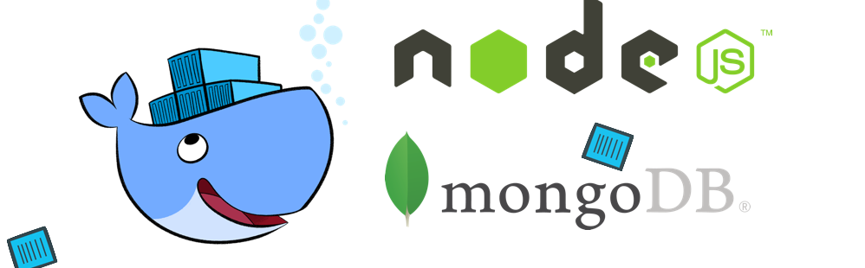
Conclusion

Slide 37
Thank You !

